Slide 1
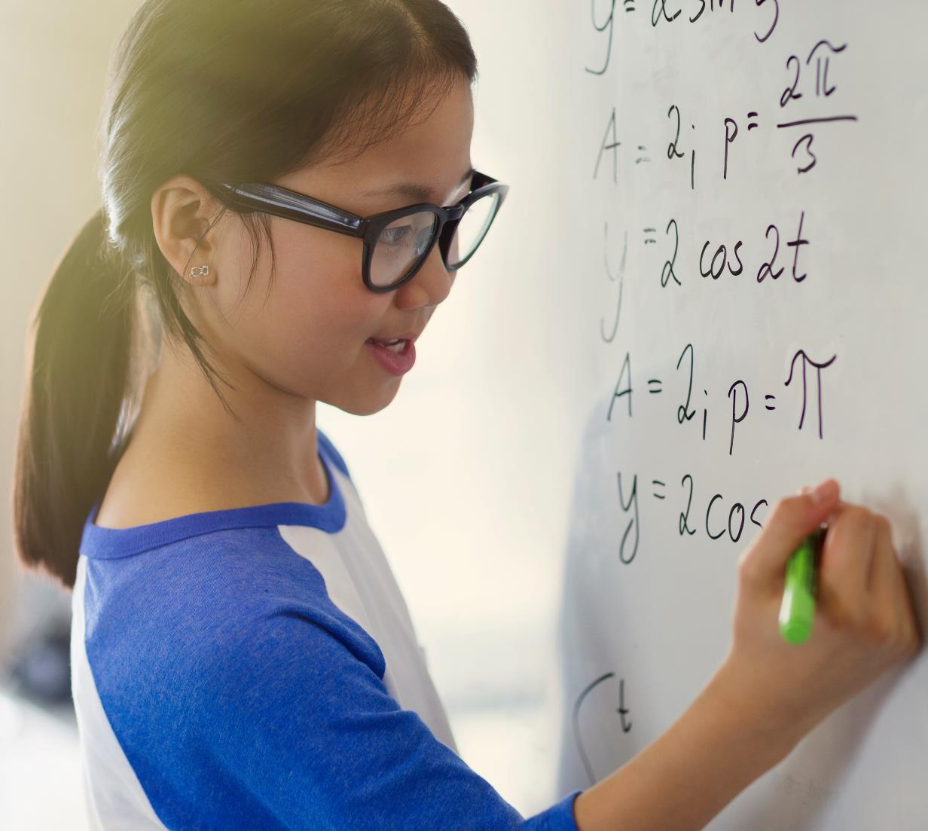
Live Lecture Visual Generation
ICT based education

Slide 2
Abstract
In traditional lectures, students often struggle to keep up with the pace of the lecturer, leading to gaps in understanding and reduced engagement. Imagination is the crucial aspect of understanding a lecture. However, lack of imagination or knowledge to imagine or due to distraction while imagining the class - causes student to lose track of the concept. This project aims to develop an AI assistant that can automate the lecture into animation, creating an engaging and interactive learning experience. The objectives of this project are to develop a software that will recognise the lecturer voice, understand the lecture, convert the voice into an animated visual and evaluate the effectiveness of the AI assistant in improving student engagement and learning outcomes. There is some animation generation software existed like DreamCloud, Dall-e, Deep-AI. However, they can only convert some text into animated visual. This software is developing to recognise the voice and provide live animation during the lecture itself. This project will be the combination of technologies such as NLP, Machine learning and graphical tools such as Turtle and Canvas. NLP and Machine learning will be used to recognise and understand the lecture. The effectiveness of the AI assistant will be evaluated through user testing and analysis of student engagement and learning outcomes. The AI assistant is expected to significantly improve student engagement and learning outcomes compared to traditional lectures. The project will demonstrate the feasibility of using AI and animation technology to automate lectures in ICT based education. The development of an AI assistant for automated lecture animation has the potential to revolutionize the way lectures are delivered and received. The project will provide important insights into the use of AI and animation technology in education, with implications for the development of new and innovative teaching methods.

Slide 3
List of Discussions
Problem Statement
Existing System
Our Approach
Methodology
Expected Results and Impact

Slide 4
Overview of the problem
Students struggling to keep up with traditional lectures, leading to gaps in understanding and reduced engagement.
Importance of imagination in understanding lectures and its impact on student learning.
Problem Statement
Existing System
Our Approach
Methodology
Expected Results

Slide 5
Problem Statement
Develop an AI assistant to automate lectures into animation for an engaging and interactive learning experience.
In this project, the demain is limited few concepts of the geometry in mathematics.
Problem Statement
Existing System
Our Approach
Methodology
Expected Results

Slide 6
Note:
Some of the slides of this presentation discusses about the concepts that helps for further development of this project.
They are presented to here to understand some crucial concepts of the project but might not related this mini project.
Problem Statement
Existing System
Our Approach
Methodology
Expected Results

Slide 7

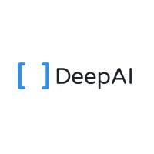
Existing System
Dall-E
An AI system that can create realistic images and art from a description in natural language.
Deep.AI
An AI tools for naturally creative humans. DeepAI offers a suite of tools that use AI to enhance your creativity.
Existing System
Problem Statement
Our Approach
Methodology
Expected Results

Slide 8
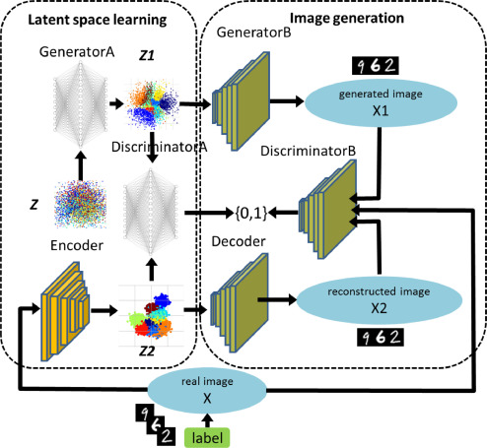
Latent Space
"latent space" refers to a conceptual space or representation where data is encoded in a compressed and meaningful form.
It is a lower-dimensional space that captures the essential features or characteristics of the input data.
In image generation tasks, one can sample points from the latent space and decode them to generate realistic new images.
Existing System
Problem Statement
Our Approach
Methodology
Expected Results

Slide 9
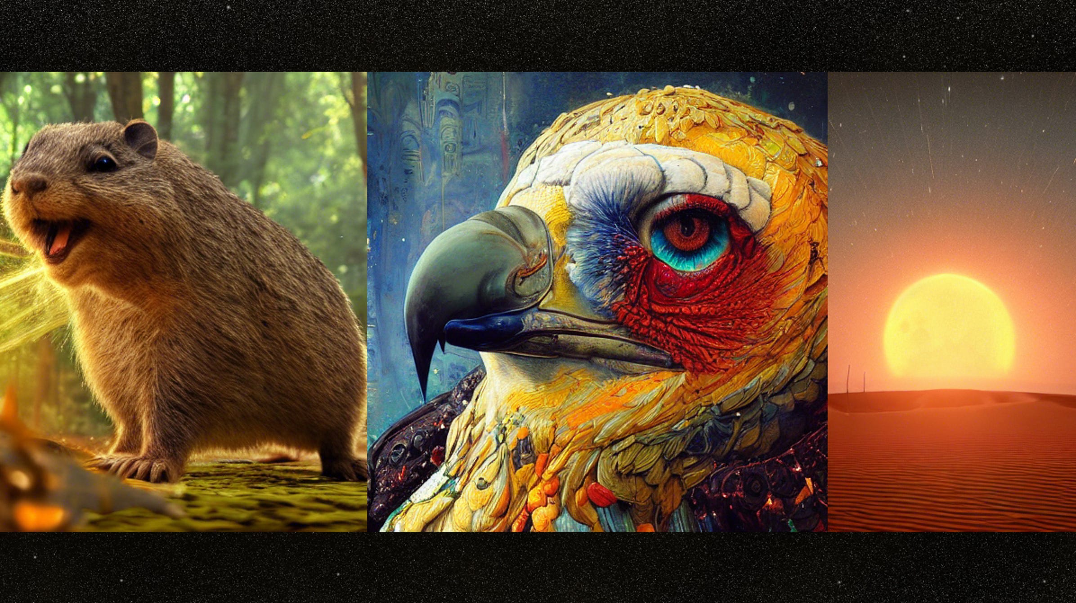
Stable diffusion
A process is designed to stabilize the evolution of the generated images as the diffusion steps progress.
Refers to the property that the generated images remain coherent and visually plausible throughout the diffusion process.
Has an ability to generate high-quality and diverse images
Existing System
Problem Statement
Our Approach
Methodology
Expected Results

Slide 10
Usage of Image Datasets
Most of those AI Image or video generation models uses image Datasets.
Drawbacks
Needs a lot of storage space for datasets
Requires a lot of processing to generate a image
Unable to produce animations which are not GIFs.
Problem Statement
Existing System
Our Approach
Methodology
Expected Results

Slide 11
Our Approach
AI assistant that recognizes the lecturer's voice, understands the lecture.
Convert the concept in visuals and present them in real time.
Instead of using a images dataset , this approach uses the classification of shapes that in combinations could create a image.
This Project is mainly a research to identify a suitable Knowledge representation that could perform this task
Our Approach
Problem Statement
Existing System
Methodology
Expected Results

Slide 12
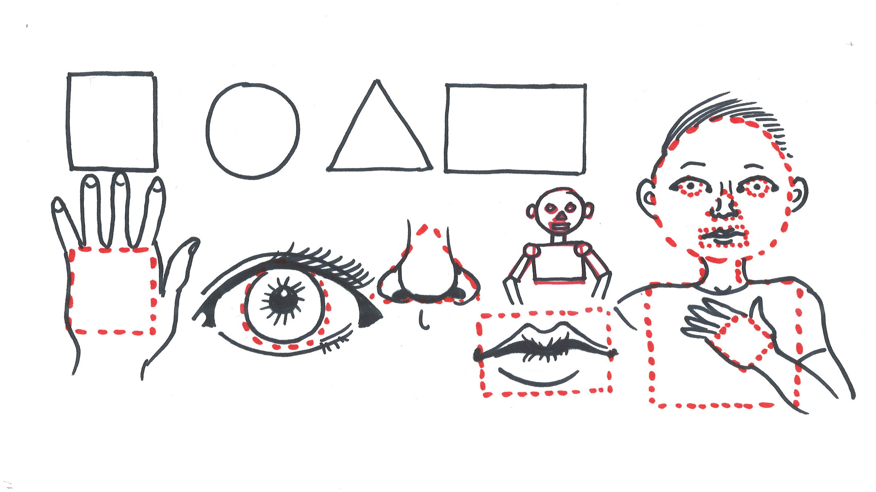
Main Methodology
Advantages:
With this procedure, it requires significantly less storage
Instead of storing pixels of each image, it stores basic information of each individual shape.
By using that data making transition from on image to relative image is easier
This can be shown as animation
This project basically uses canvas and turtle during research
Converting an object into combination of basic shapes
Methodology
Problem Statement
Existing System
Our Approach
Expected Results

Slide 13
Things to remember
Since this project is fixed to a small domain, the methodology is partially being used.
In this project we focus on the basic shapes and work with those shapes without touching the image generation yet.
The methodology is presented for future use case and to present our main idea.
Methodology
Problem Statement
Existing System
Our Approach
Expected Results

Slide 14
Initial Knowledge Representation
Hierarchy of shapes
Shape
Edges/Lines
Arcs
points
length
Angles
Arc length
center
Methodology
Problem Statement
Existing System
Our Approach
Expected Results

Slide 15
Conclusion
This project will be expected perform the following tasks in the domain of geometry
Represent the concept that is being thought during the lecture, using the lectures voice.
Mostly the lecture should belong to the basic shapes concept.
Expected Results
Problem Statement
Existing System
Our Approach
Methodology

Slide 16
Limitations of this project
The project is limited to a small domain.
This project is subject to work in only ideal cases , such as:
Clear voice with no ambiguous meaning words.
Concept belongs to only specified subject.
Usage of proper mic.
Expected Results
Problem Statement
Existing System
Our Approach
Methodology

Slide 17
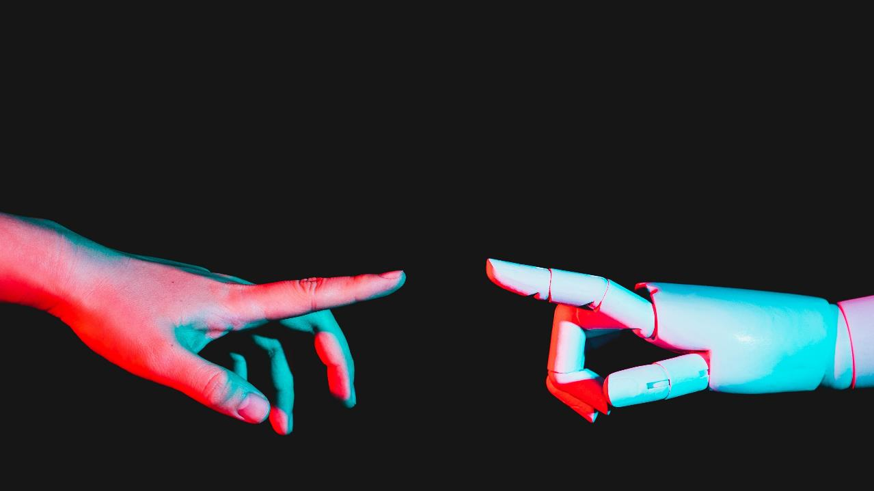
Summary

Slide 18
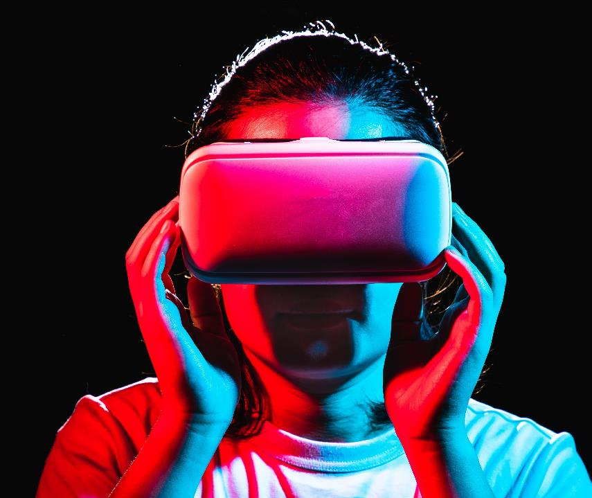
Thank you
Team Number: 25
Team Members:
Uday Sankar Gottipalli – S180443
Sai Kumar Tamminana – S180020
Sankar Rao Vantaku – S180681
Guide:
Mr. Dileep Korada (Assistant Professor)

